Slide 1
Solar Power Forecasting Using Machine Learning and Flask
A Step-by-Step Implementation Guide
Team members
Shilpa Varadharajan
Vaishnavi Wagaskar
Bhargav kumar
Bala Krishna
Keshab Chandra

Slide 2
Agenda
Project Objectives
Dataset Overview
Model Selection
Flask Integration and Building the Web Interface
Deployment
Conclusion

Slide 3

Project Objectives
Objective:
Predict energy production, a continuous variable, in a regression project.
Primary Goal:
Model energy production based on environmental variables.

Slide 4
Dataset Overview
Solar Power Generation Data Overview
File: solarpowergeneration.csv
Rows: 2920 (Instances)
Columns: 10 (Variables)
Variables:
distance_to_solar_noon: Radians
temperature: Daily average temperature, °C
wind_direction: Daily average wind direction, ° (0-360)
wind_speed: Daily average wind speed, m/s
sky_cover: Scale of 0 to 4 (0: clear, 4: wholly covered)
visibility: Kilometers
humidity: Percentage
average_wind_speed: 3-hour average wind speed, m/s
average_pressure: 3-hour average barometric pressure, inches of mercury
power_generated (Target): Joules (3-hour intervals)

Slide 5
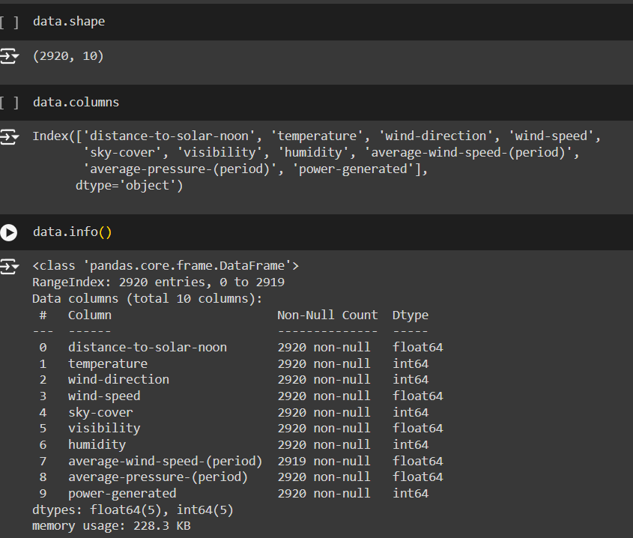
Dataset info

Slide 6
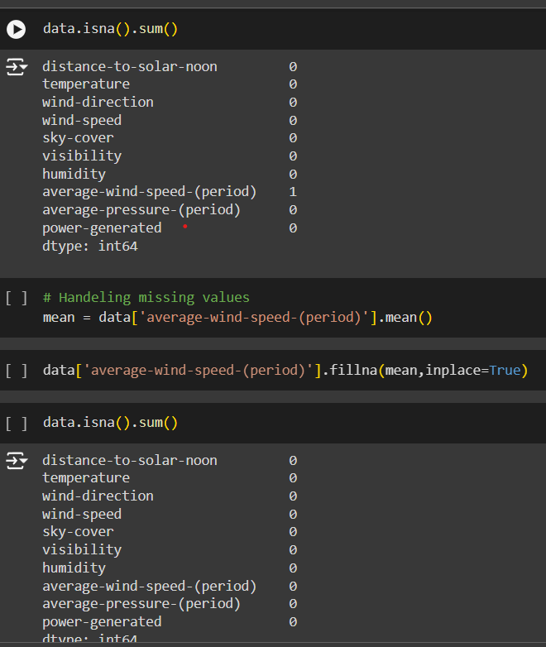
Data preprocessing
Steps in data preprocessing:
Cleaning the data: Cleaning the data involves handling the missing values, detecting the outliers and removing outliers.
Feature Engineering: Feature Engineering involves creating additional relevant features.

Slide 7
Exploratory Data Analysis (EDA) Objectives
Analyze and investigate datasets
Summarize main characteristics
Often using data visualization methods
Importance of EDA:
Improper EDA can hinder subsequent steps in the model-building process

Slide 8
Visualization Tools for Exploring Relationships
Box Plots
Histograms
Heatmap
Line Graphs
Scatter Plots

Slide 9
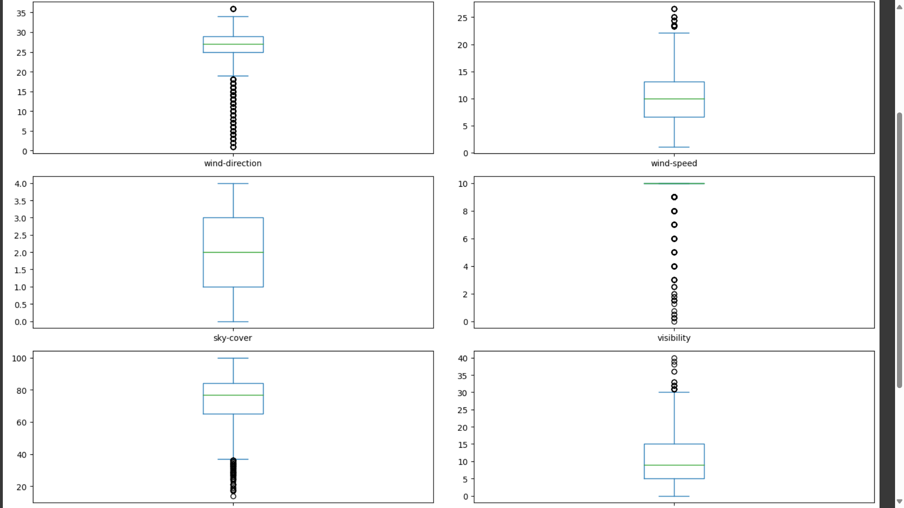
Box Plots
By using box plots we identify the outliers in datasets, Skewness of the data.

Slide 10
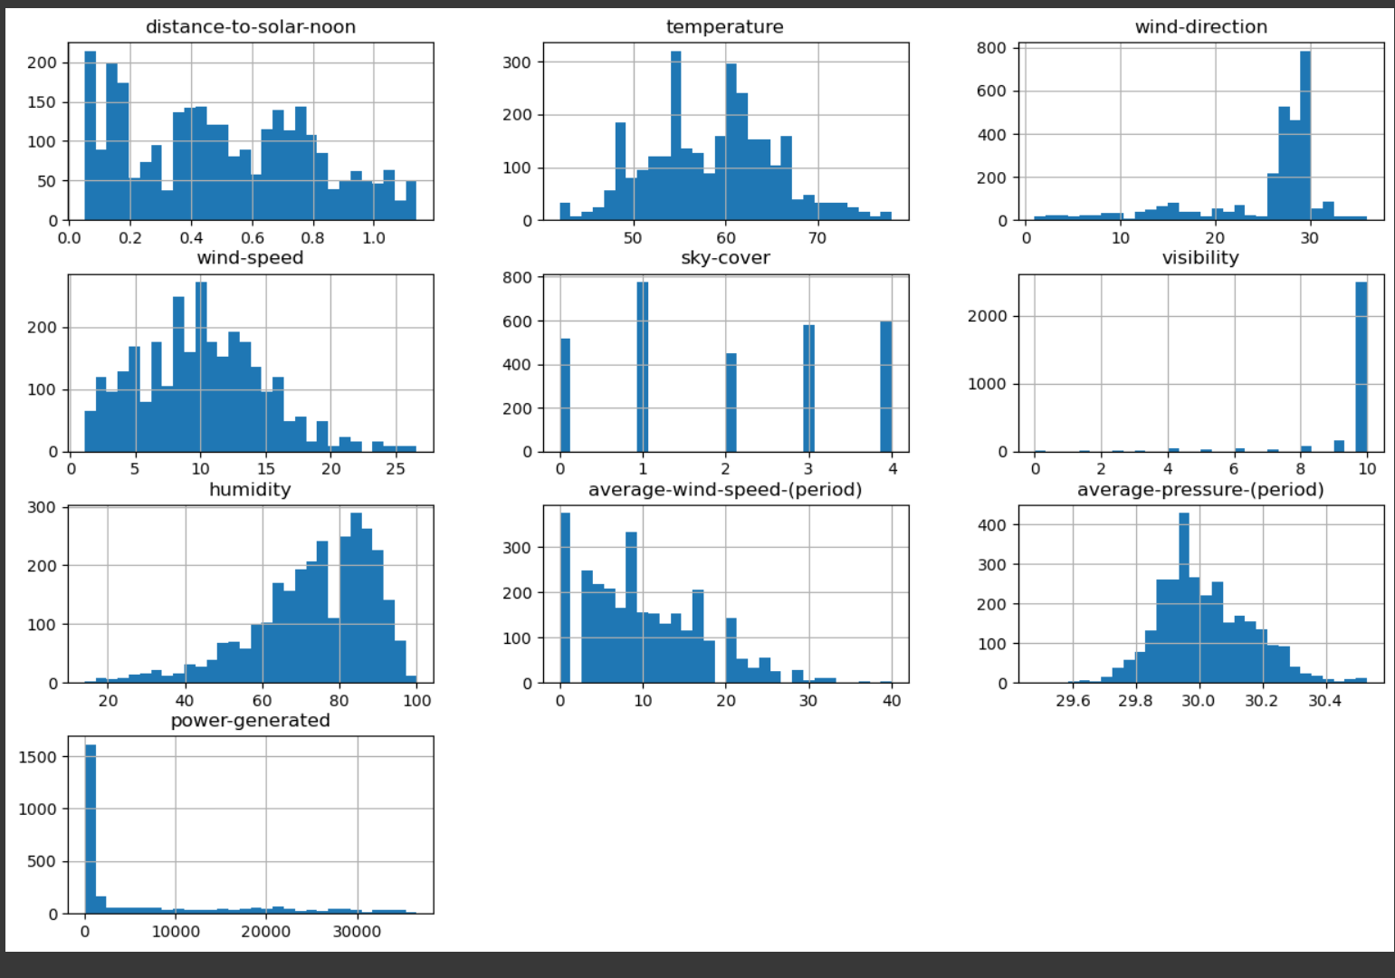
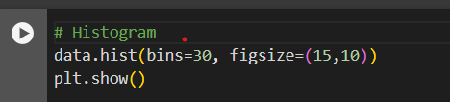
Histograms
Histogram represents the distribution of a continuous numerical data
Histograms helps to identify, whether it is normal, skewed, uniform.

Slide 11
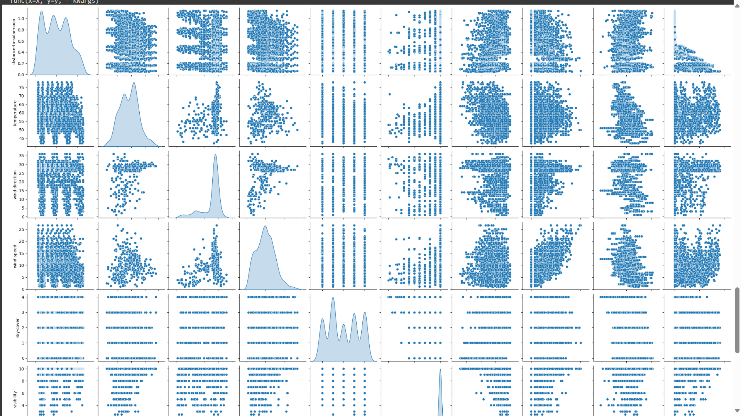
Pair plot
By using pair plots we identify the relation between variables.
By identifying the relation between variables, we can decide the which features are have more relevant to the model building.

Slide 12
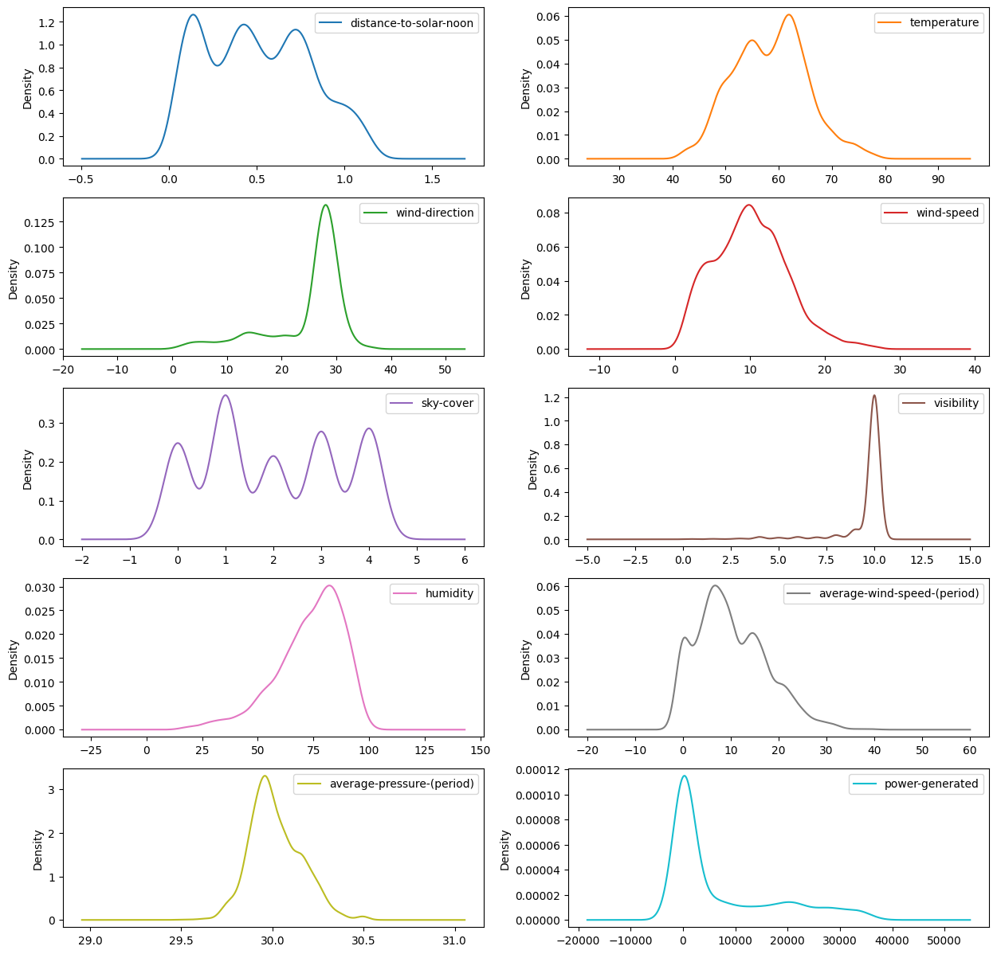
Density Graph

Slide 13
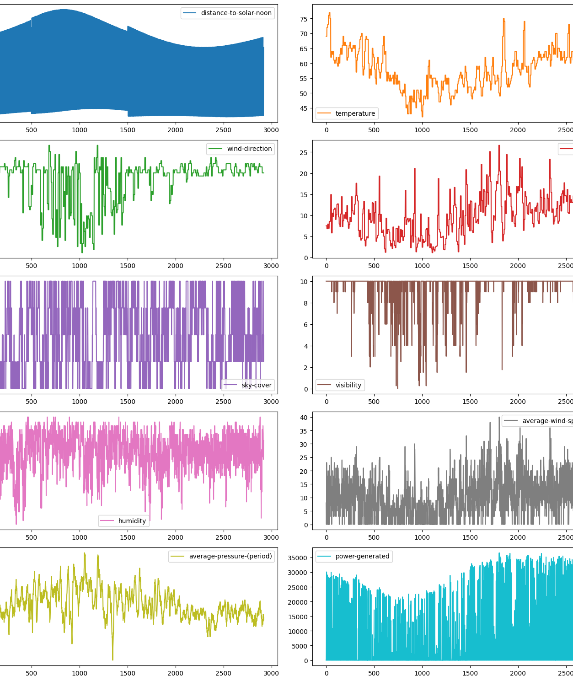
Line graph

Slide 14
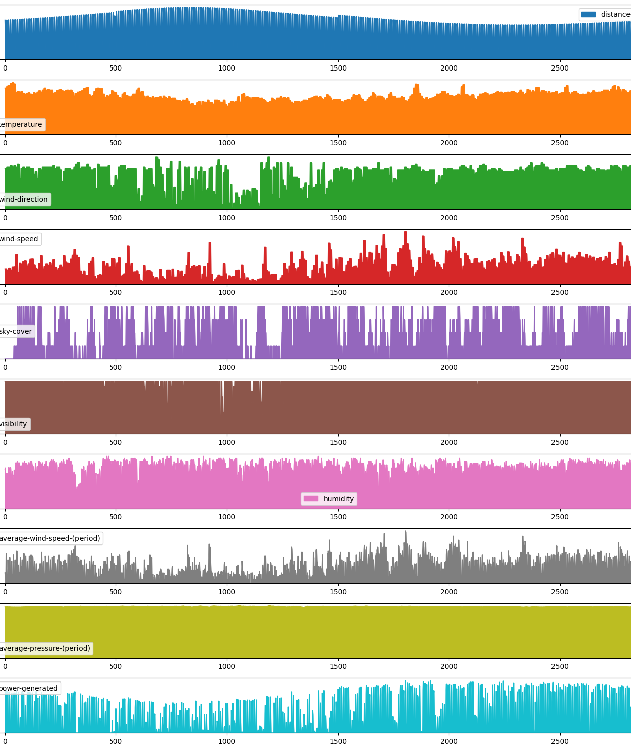
Area Graph

Slide 15
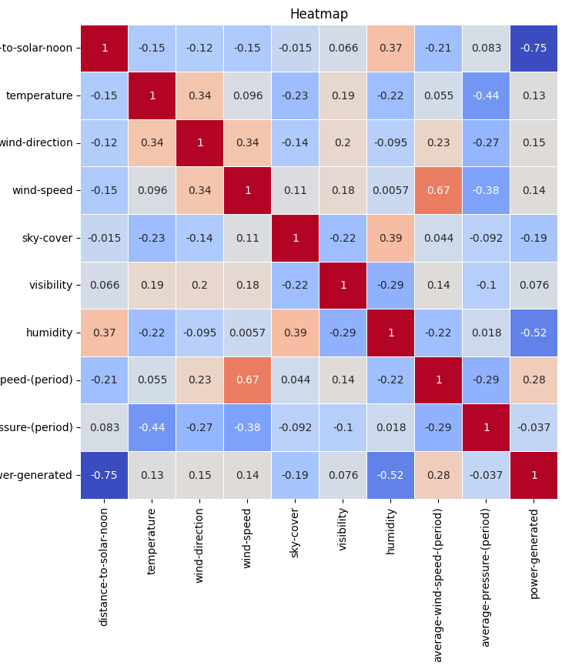
Heat Map
Heatmap is used to display the correlation matrix.

Slide 16
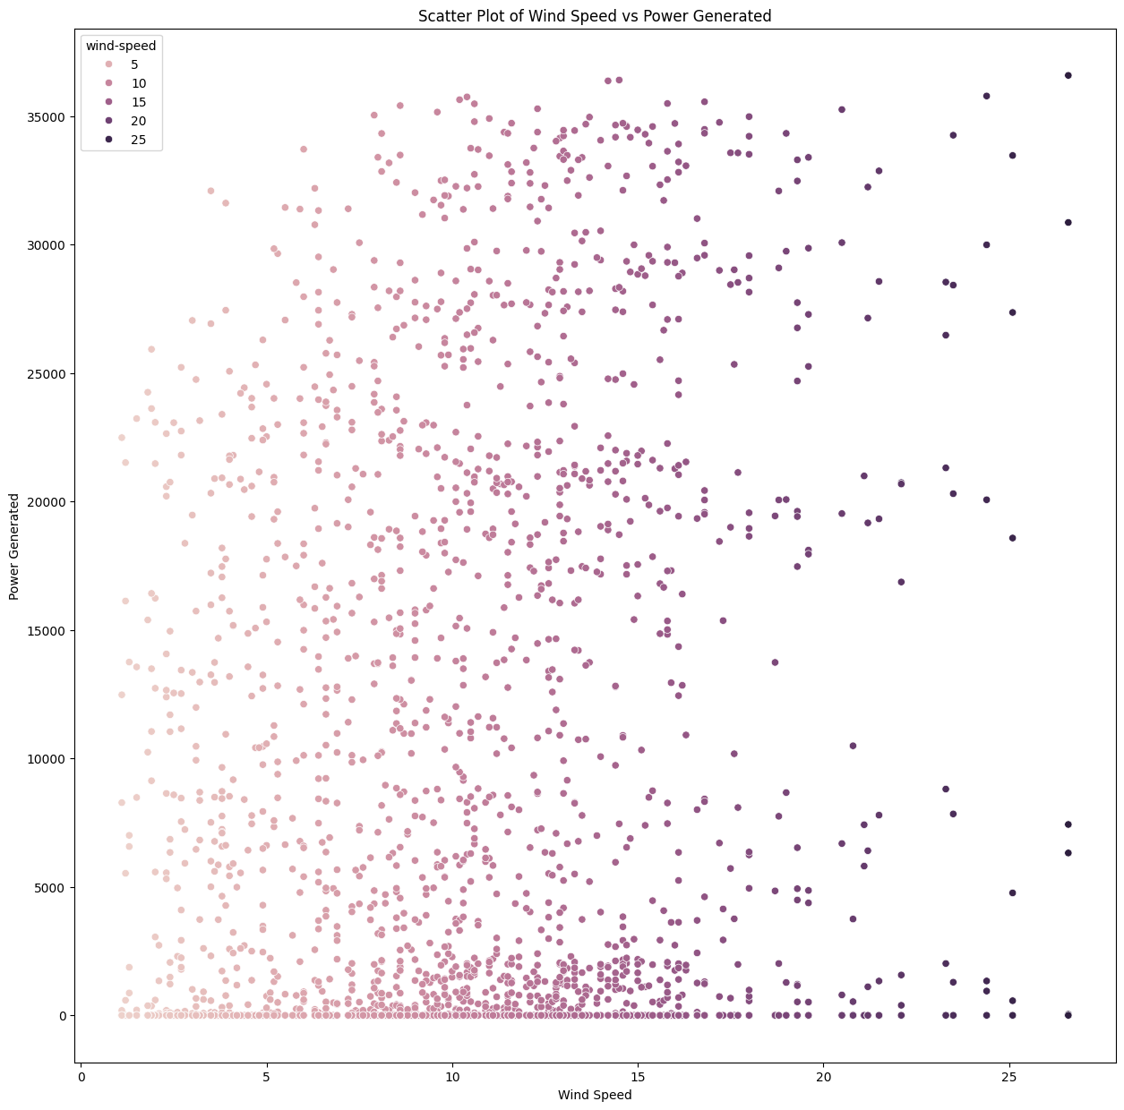
SCATTER PLOT OF WIND SPEED VS POWER GENERATED
It shows the positive correlation between the wind speed and power generated.
Which means as wind speed increases, the power generation also tends to increase.

Slide 17
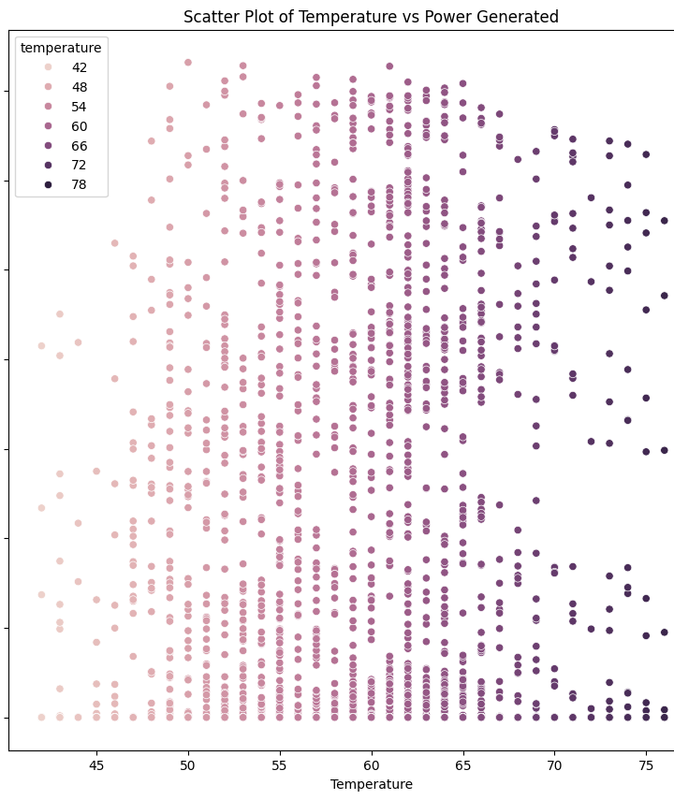
SCATTER PLOT OF TEMPERATURE VS POWER GENERATED
It shows the positive correlation between the temperature and power generated.
Which means as wind speed increases, the power generation also tends to increase.

Slide 18
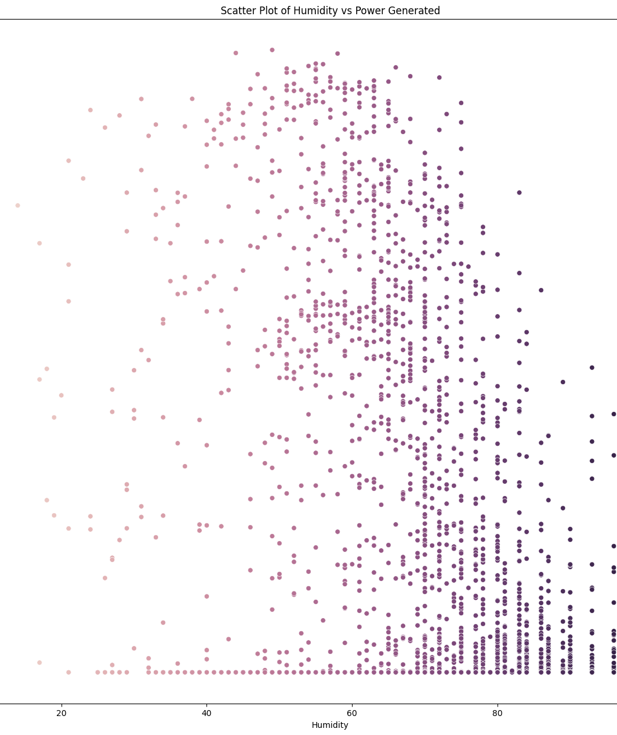
SCATTER PLOT OF TEMPERATURE VS POWER GENERATED
It shows the positive correlation between the wind speed and power generated.
Which means as wind speed increases, the power generation also tends to increase.

Slide 19
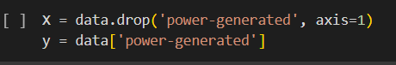
Splitting Data
We split the data into training and testing sets.
Typical split was 80% for training, 20% for testing.

Slide 20
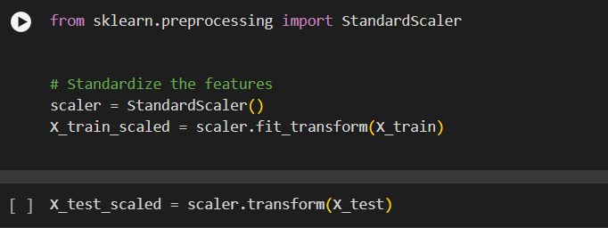
Standardization

Slide 21
Model Selection
Different Regression Models:
Linear Regression
Random Forest
Gradient Boosting
Support Vector Regressor
K-Nearest Neighbors Regressor
Decision Tree
XGBoost

Slide 22
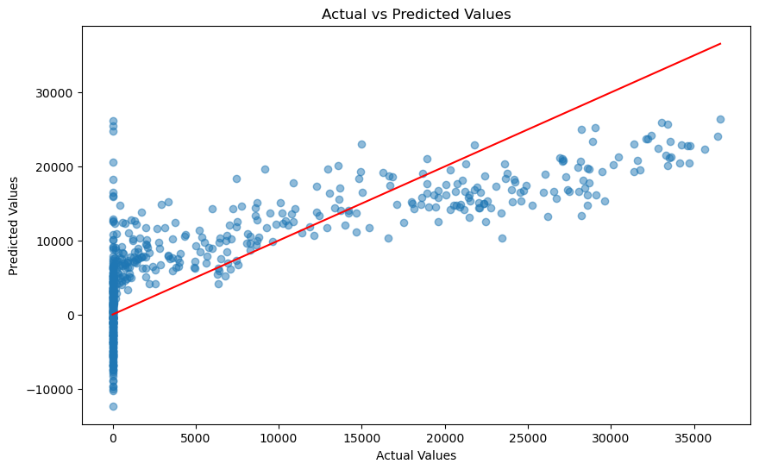
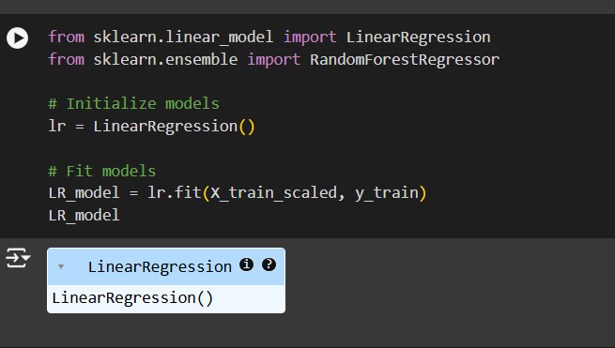
Linear regression

Slide 23
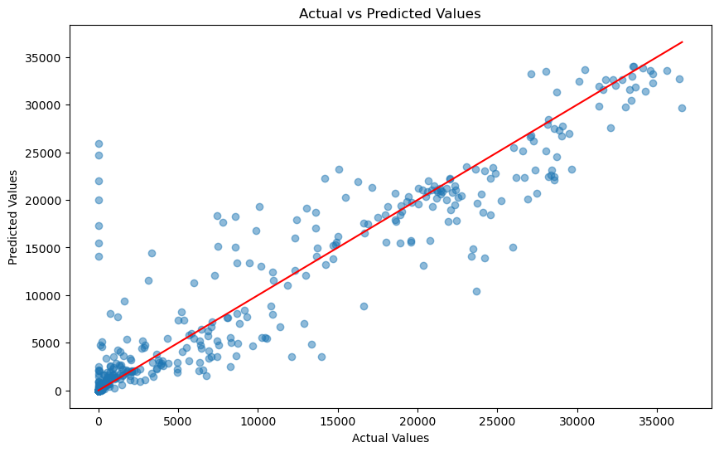
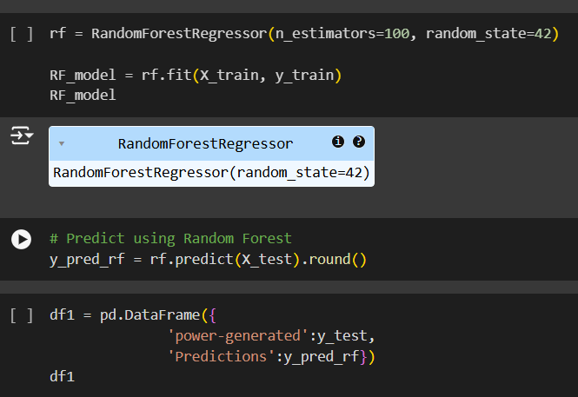
Random Forest

Slide 24
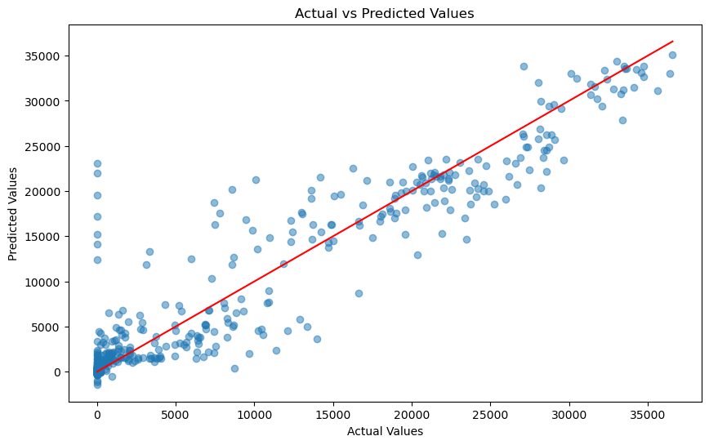
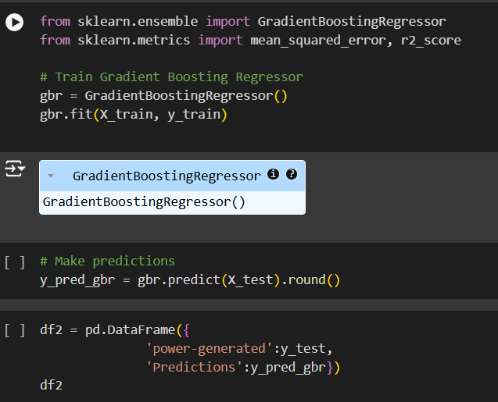
Gradient boosting

Slide 25
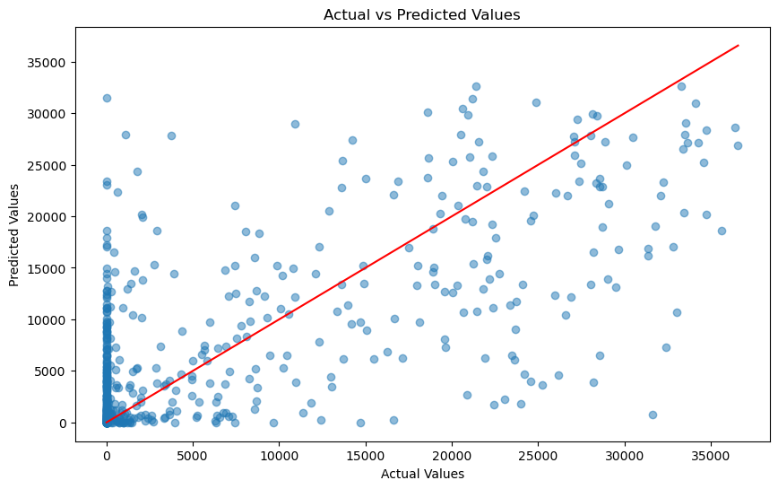
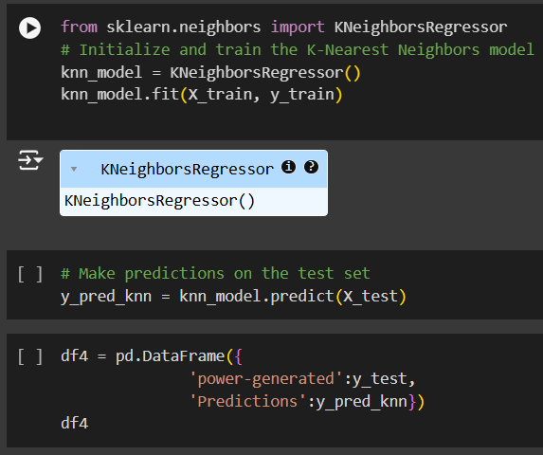
K neighbors

Slide 26
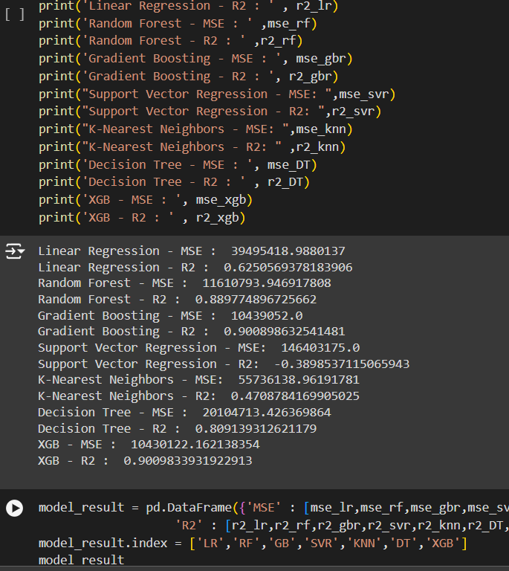
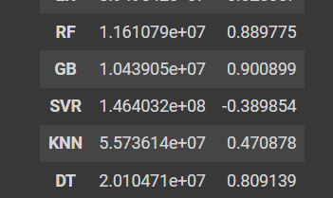
Model Evalution

Slide 27
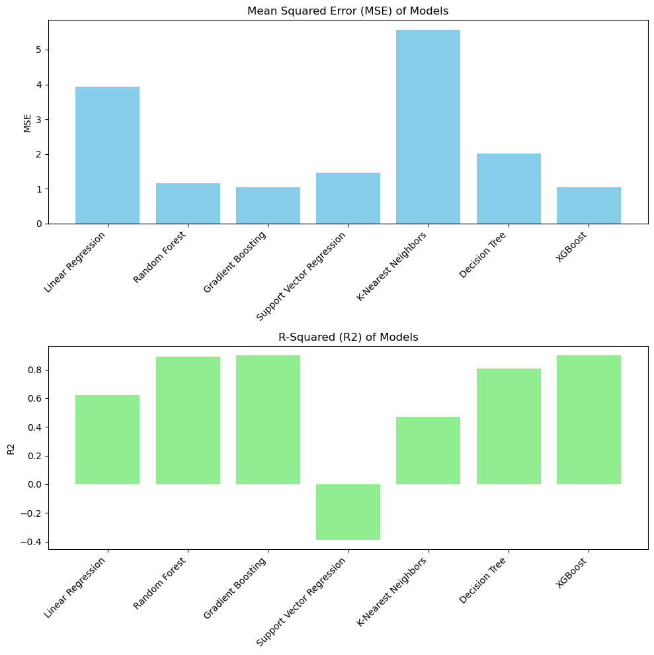
Evalution
By using metrics like mean squared error(mse), R² we check the model performance.
According to the model performance based on metrics we finalize the Random forest regressor, Gradient Boosting, Xg Boost for deployment.

Slide 28
Flask Integration and Building the Web Interface

Slide 29
Overview of the Flask Application
Flask Application for Solar Power Forecasting
Purpose: Web app to predict solar power generation using various regression models.
Components:
app.py: Main Flask application script
index.html: Home page template
form.html: Form for user input and prediction

Slide 30
app.py – Main Application Script
Imports:
Flask for web framework
pickle for model loading
StandardScaler for data scaling
Model Loading:
Loads Random Forest, Gradient Boosting, and XGBoost models
Handles missing files and errors
Routes:
/: Home page
/form/<model_type>: Form for model selection
/submit_form: Handles form submission and prediction

Slide 31
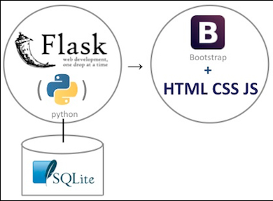
from flask import Flask, render_template, request
import pickle
from sklearn.preprocessing import StandardScaler
app = Flask(__name__)
# Load models and scaler
...
@app.route('/')
def index():
return render_template('index.html')
...

Slide 32
Deployment
Deploying a Flask App from Git on PythonAnywhere
Steps:
Prepare Your Repository
Ensure your Flask app is in a Git repository.
Include a requirements.txt file with all dependencies.
Set Up PythonAnywhere Account
Sign in to PythonAnywhere.
3. Create a New Web App
Go to the "Web" tab.
Click "Add a new web app."
Choose "Flask" and select your Python version.

Slide 33
continue
Set Up Virtual Environment
Clone Your Repository
Navigate to your project directory.
Clone the repository:
git clone https://github.com/yourusername/your-repo.git
Configure Your Flask App
Edit the WSGI file in the "Web" tab:
from yourapp import app as application
Set Up Environment Variables
Configure any necessary environment variables in the "Web" tab settings.
url: https://bhargav.pythonanywhere.com/
Open a Bash console.
mkvirtualenv myenv --python=python3.x
Create a virtual environment
pip install -r requirements.txt
Install dependencies
pip install -r requirements.txt

Slide 34
Difficulties encountered on each stage
Model Building
Identifying and creating which features are most relevant can be challenging.
Choosing right algorithm can be difficult.
Model Evaluation
Understanding and interpreting evaluation metrics and how they relate to model performance can be complex.
Overfitting and Underfitting
Model Deployment
Continuously monitoring model performance in production and detecting issues can be difficult.

Slide 35
Thank you
Group 6

